Slide 1

Speak Fluently & Confidently A2- Course 1

Slide 2
Session 8- Talking about Family
Part 1-: The Chance of a Lifetime ( Listening)
Part 2: What would you say in the following
situations? ( More Idioms & collocations)
Part 3: Speaking Practice
https://befluent.me/

Slide 3
Session 8- Talking about Family
Part 1-: The Chance of a Lifetime
( Listening )
https://befluent.me/

Slide 4
Lesson 08: The Chance of a Lifetime
Jenkins is telling David about a “great opportunity” – but should David invest in it? Listen to their conversation and answer the comprehension questions below:
Listening Comprehension
Jenkins wants David to invest...
a. $4,000 b. $14,000 c. $40,000
What's the relationship between the two men?
childhood friends
cousins
co-workers
The last bad investment David made was in...
a failed company
a house
a car
Jenkins is excited about a company in the area of...
agriculture
manufacturing
technology
David doesn't want to risk his money because...
he's saving for a house
his son will go to college soon
he'd like to take a vacation with his wife
Jenkins found out about this opportunity from...
hearing about it in the news
researching on the internet
a man who came into his shop

Slide 5



Conversation Text
Vocabulary
David: No way… uh-uh… not my hard-earned dollars.
hard-earned dollars = money that required a lot of work to earn
Jenkins: It’s the chance of a lifetime, Dave. Lighten up, man.
lighten up = don’t be so serious
David: Jenkins, you’re nuts if you think I’m going to invest four thousand dollars into a stock that I know nothing about.
nuts = a slang word for “crazy”
stock = a piece of ownership of a company
Jenkins: Dave, I’m your best friend. We’ve known each other since the second grade. You can trust me, man. Would I lead you astray?
lead you astray = deceive you, take you in the wrong direction
David: Yes, you would. Remember the time you talked me into buying that 1967 convertible Volkswagen? The chance of a lifetime you told me… that clunker cost me more in repairs than I care to remember.
talked me into = convinced me
clunker = a slang word for an old car that tends to break down
Jenkins: Okay…okay…so I was wrong about that. No one’s perfect. But this is different, Dave. Ocean Tech is going to take the world by surprise. Do you know that Ocean Tech is developing a new sonar technology that the Navy is interested in buying? Dave, if we invest now we’ll be millionaires! Ocean Tech stocks are dirt cheap right now.
take the world by surprise = surprise and amaze the world
sonar = technology for making scans underwater
dirt cheap = extremely inexpensive

Slide 6



David: I’ve never even heard of Ocean Tech, Jenkins, and I work for the Department of Defense. If a deal involving the Navy was in the works, I would be aware of it.
Vocabulary
in the works = in progress, or being planned
Jenkins: Dude – I’m your pal, I’m offering you a chance of a lifetime and all you do is give me the third degree.
pal = an informal word for “friend”
David: Jenkins, I have eight thousand dollars in savings. Mandy and I are getting married in four months. I still have to save up another seven thousand dollars to make the down payment for the house I want to buy Mandy. I ain’t about to gamble with my money.
give me the third degree = ask a lot of aggressive questions
down payment = the initial payment for a house
I ain’t = a very informal way to say I’m not
Jenkins: But just think… if you buy four thousand dollars’ worth of Ocean Tech stocks at twenty dollars a stock… and then Ocean Tech sells the stocks for eighty-dollars, you’ll make a fortune.
gamble = take risks with money, which could result in losing it
make a fortune = get a LOT of money
David: Nothing in life is that easy, Jenkins… sounds to me like this Ocean Tech company is a scam. And man, do you fall for scams. Let me guess… some smooth-
talking guy in a fancy suit driving a fancy car came into your coffee shop and told you about Ocean Tech… maybe even showed you some papers… charts and graphs?
scam = fake opportunity
fall for = believe in something that isn’t true
smooth-talking = someone who speaks
well and can convince people

Slide 7



Jenkins: Uh…well…okay, sure…Mr. Rogers showed me some papers. But the papers he showed me were well researched.
Vocabulary
lingo = specialized vocabulary in a certain area
David: And he used a lot of business lingo, right?
Jenkins: He spoke with intelligent understanding of the business world.
complimentary = free
on top of that = in
addition
David: Uh, huh, sure. I bet you even gave him
complimentary coffee?
legit = legitimate, real
Jenkins: I… didn’t charge him for his cappuccino, if that’s what you mean.
for crying out loud =
an informal expression used to express annoyance
David: So your coffee shop didn’t even make a profit on this guy. And on top of that, you gave him a four thousand dollar check.
I was taken = an informal way to say I was cheated/deceived
Jenkins: Hey, Dave, what’s with you? This guy was
legit. He was driving a Porsche for crying out loud.
David: Jenkins, did you even take the time to research and see if Ocean Tech was a real company?
Jenkins: I…uh…no…oh man, I was taken, wasn’t I?
David: You were taken, but I won’t be. I’ll see you later.

Slide 8
Vocabulary Quiz
Complete each sentence with the right word. Two words are not used.
complimentary | in the works | making a fortune | pals
dirt cheap | legit | nuts | stocks
gambling | lighten up | on top of that | talk me into
After in the diamond market, the Johnsons made numerous donations to charity.
At the library's annual book sale, the books were - it was 10 for a dollar!
Chris has already founded two companies, and in an interview he said a third was - to be launched next month.
Every time you buy a pair of shoes at that store, you get a pair of extra shoelaces.
He lost all his money by on sports games and horse races.
I've already made my decision. Please don't try to changing my mind.
My son and his stayed up all night playing video games.
She's if she thinks she can run a marathon with zero training. There's no way she'll make it.
That job opportunity sounds too good to be true. Are you sure it's
?
Why do you always have to take things so personally? I wish you'd
; I was just joking.

Slide 9
Speaking Task
Jenkins is more impulsive (acts spontaneously without thinking) and David is more cautious (slow to act, wants to analyze the situation first). Which one are you? Would you describe yourself as a risk-taker (someone who likes to take risks) or as risk- averse (someone who prefers to avoid risks)? Also, talk about a time when you have taken some sort of risk – it doesn’t have to be financially – and what happened as a result.
Answers
Comprehension Questions
a
a
c
c
a
c
Vocabulary Quiz
making a fortune
dirt cheap
in the works
complimentary
gambling
talk me into
pals
nuts
legit
lighten up

Slide 10
Session 8- Talking about Family
Part 2: What would you say in the following
situations? ( More Idioms & collocations)
https://befluent.me/

Slide 11
Session 8- Talking about Family
Like Father, Like Son
Meaning: Sons inherit their fathers’ traits and preferences, often even without realizing it.
Example: John was a great fisherman, and there’s his son Matt out on the water. Like father, like son.
Run in the Family
Meaning: Be inherited (as a trait) by multiple members of a family
Example: I’m not surprised Maria has started playing in a band. Musical talent runs in her family.
One Big Happy Family
Meaning: A group of people who live or work together or in close proximity
Family Man
Meaning: A man devoted to taking care of his wife and children
A Helicopter Parent
Meaning: a parent who overprotects and overcontrols their children, hovering around like a helicopter and monitoring everything that the children do
Example: His mum was a real helicopter parent and sent instructions to the kitchen on how to cook her son’s rice for every meal.
https://befluent.me/

Slide 12
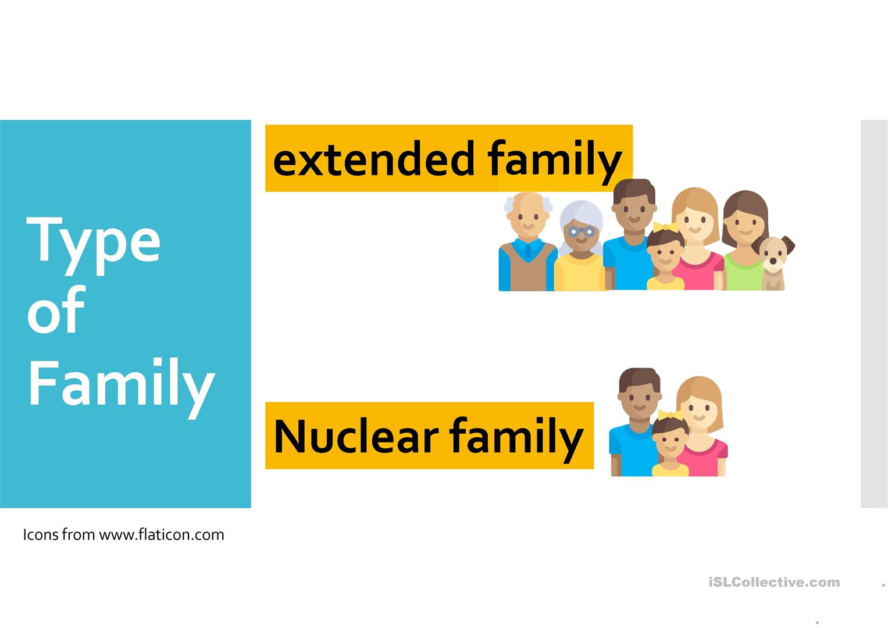
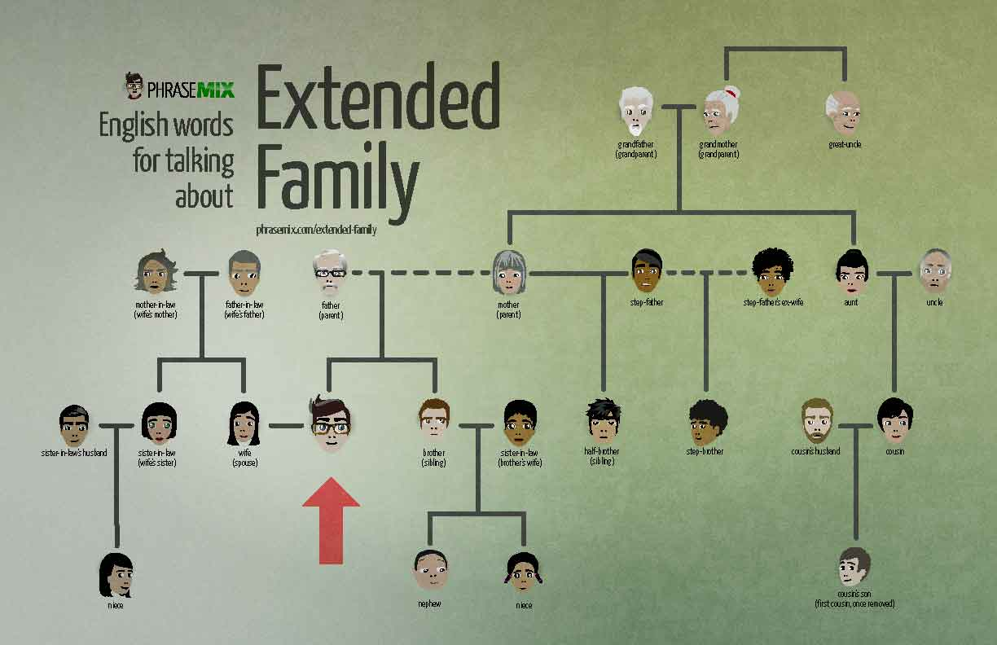
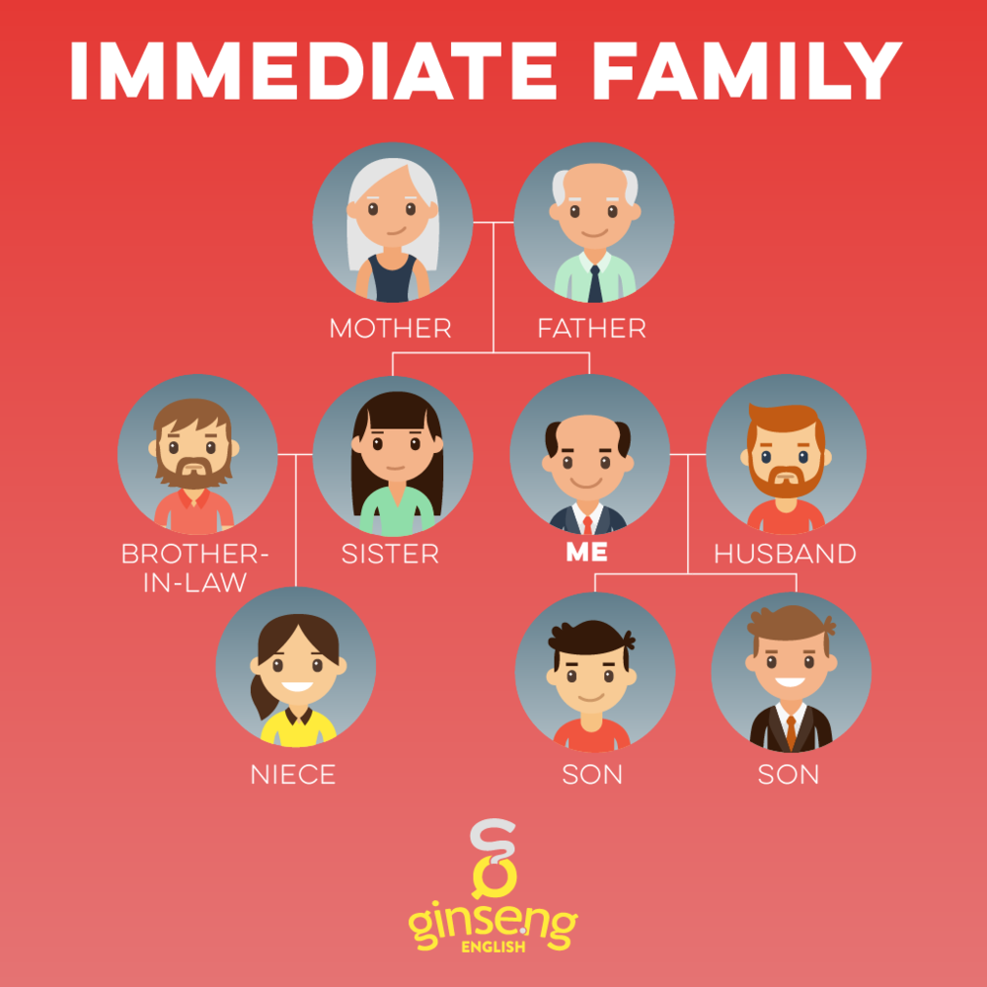
Session 8- Talking about Family
= Nuclear Family
= Immediate Family
https://befluent.me/

Slide 13
Session 8- Talking about Family
Part 3: Speaking Practice
https://befluent.me/

Slide 14
Session 8- Talking about Family
What comes to your mind when you hear the word family?
Tell me about your family using some of the idioms just covered.
Do you have a big family? / Would you like to have a big or a small family?
Are friends more important than family? What do you think?
What do you think of assigning chores to children in the family?
What do you like doing when you spend time with your family?
Did you ever meet any of your great grandparents?
How did you get your name? Who are you named after?
What is the most important thing your parents taught you?
If you could have a different number of siblings and children, what would it be? Why?
https://befluent.me/

Slide 15

Session 8- Talking about Family
11. If you were offered an excellent job opportunity abroad, would you consider leaving your family for an indefinite period of time?
12. There is much talk recently of increased social problems due to family breakdown. Is this true?
13. Do you ever get tired of family duties?
14. Do you consider close friends as family? Explain why?
15. Do you like taking photos with your family?
16. Can you describe this picture?
https://befluent.me/

Slide 16
Session 8- Talking about Family
Thank you!☺
https://befluent.me/

